Slide 1
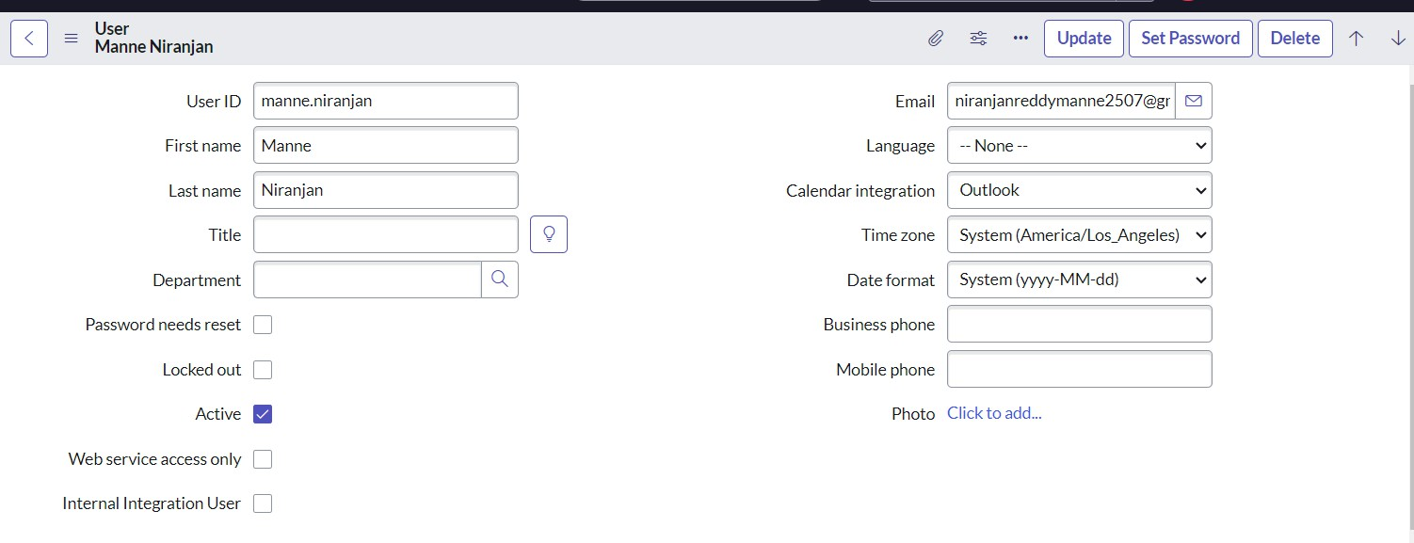
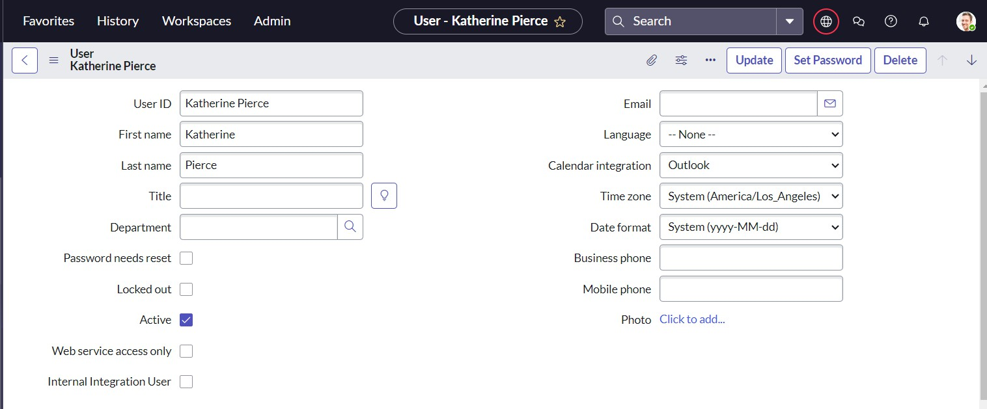
Step by Step procedure of Project
Step-1: creation of users
Open service now.
Click on All >> search for users
Select Users under system security
Click on new
Fill the following details to create a new user
Click on submit
Create one more user:
Create another user with the following details

Slide 2
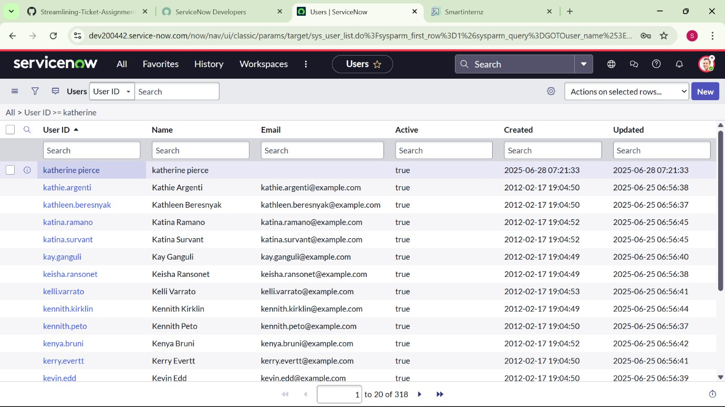
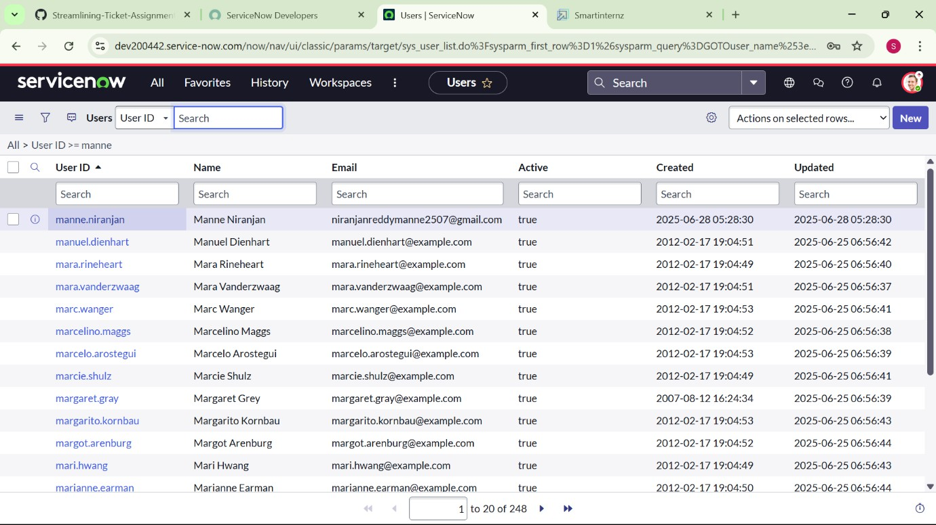
8. Click on submit
Result:
Step-2: Creation of Groups
1. Open service now.

Slide 3
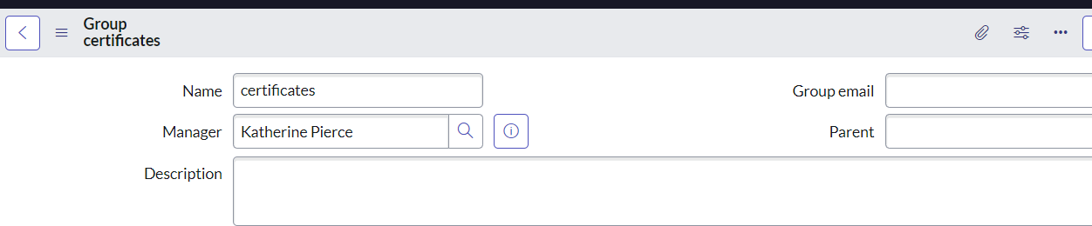
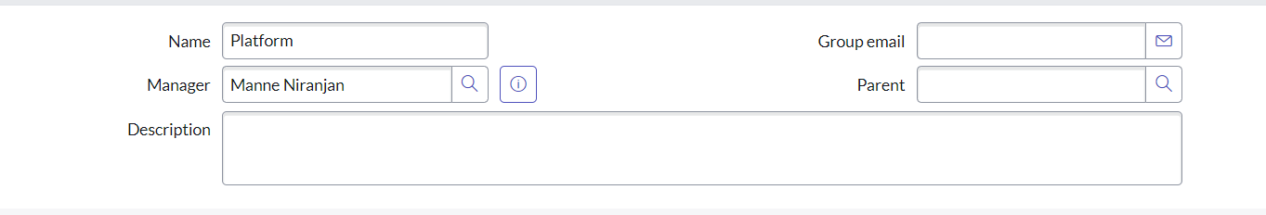
Click on All >> search for groups
Select groups under system security
Click on new
Fill the following details to create a new group
6. Click on submit
Create one more group: Create one more group:
1. Create another group with the following details
2. Click on submit

Slide 4
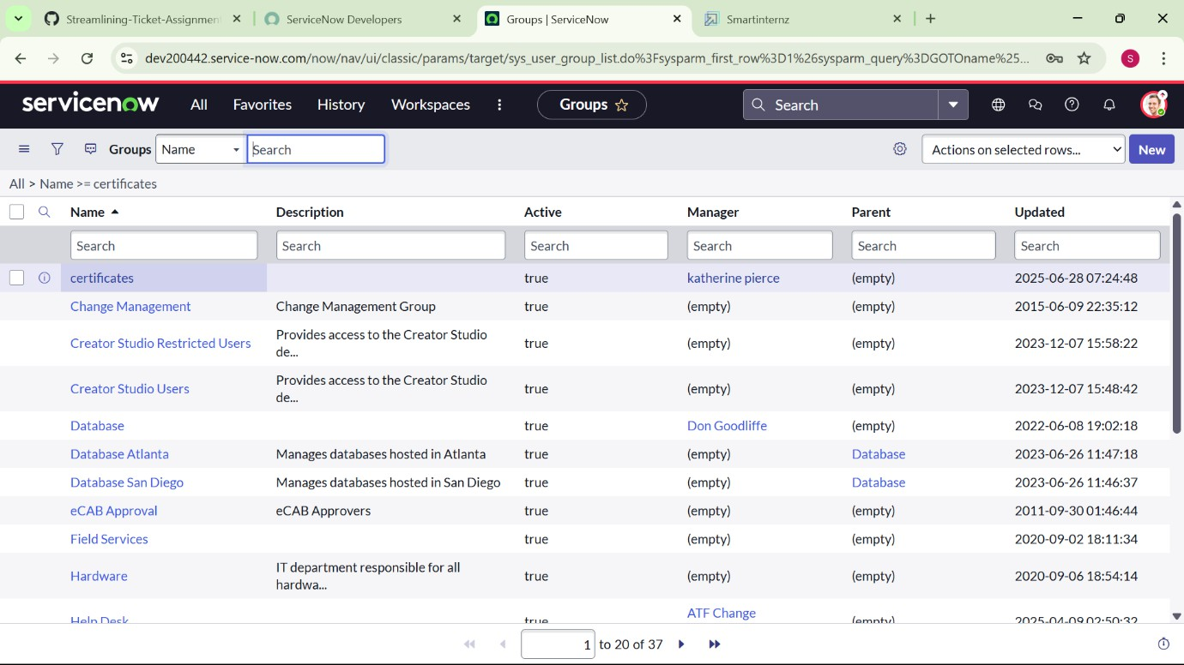
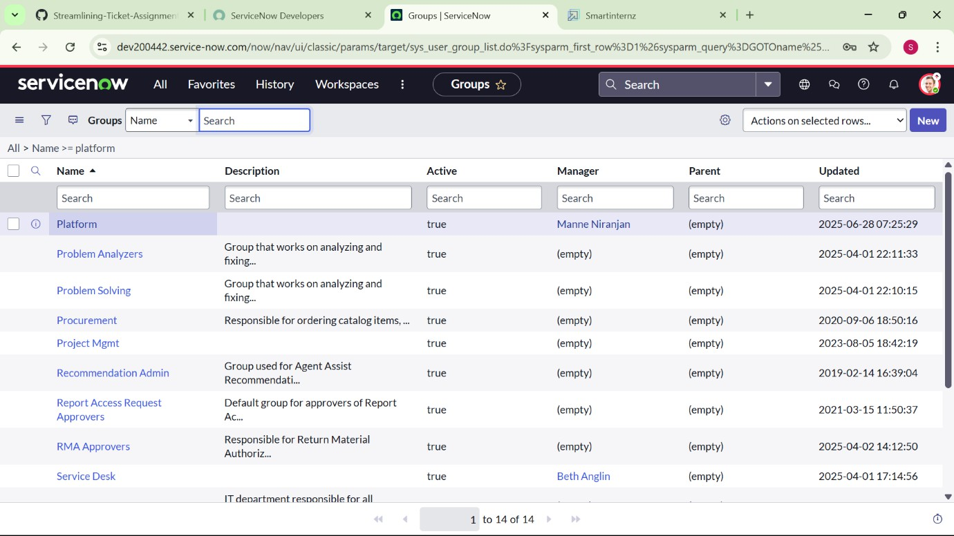
Result:
Step-3: Creation of Roles
Open service now.
Click on All >> search for roles

Slide 5
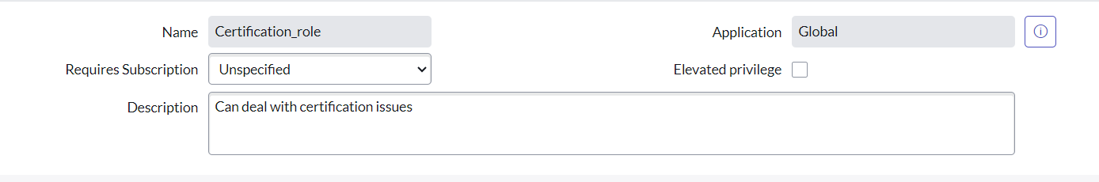
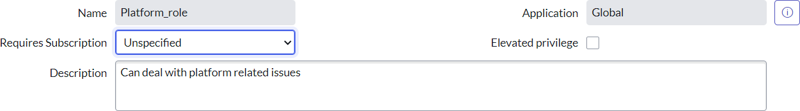
Select roles under system security
Click on new
Fill the following details to create a new role
6. Click on submit Create one more role:
Create another role with the following details
Click on submit

Slide 6
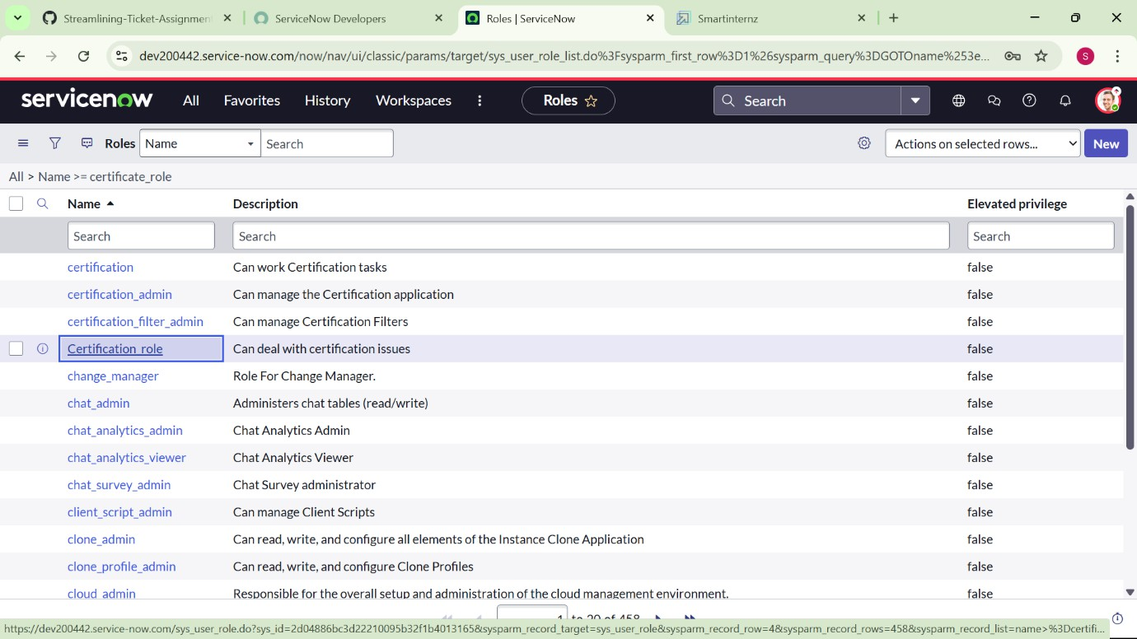
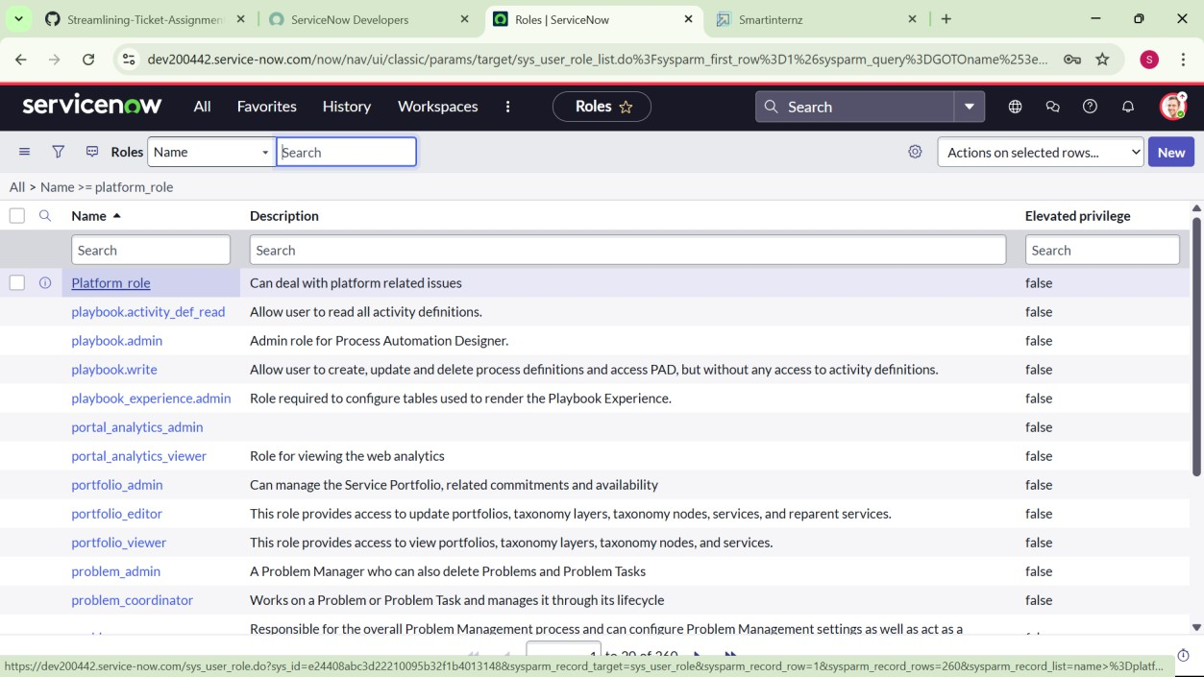
Result:
Step-4: Creation of Tables
1. Open service now.

Slide 7
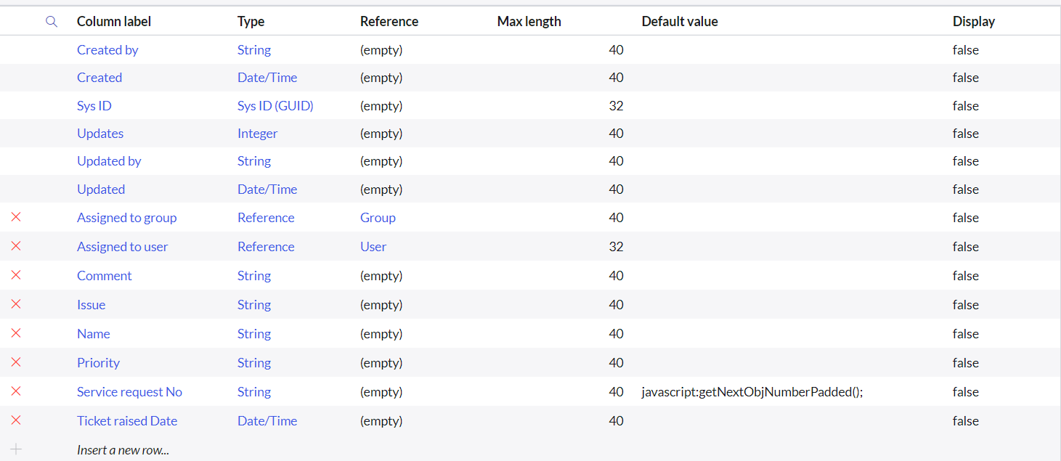
Click on All >> search for tables
Select tables under system definition
Click on new
Fill the following details to create a new table Label : Operations related
Check the boxes Create module & Create mobile module
Under new menu name : Operations related
Under table columns give the columns
Click on submit
Create choices for the issue filed by using form design Choices are
unable to login to platform
404 error
regarding certificates
regarding user expired

Slide 8
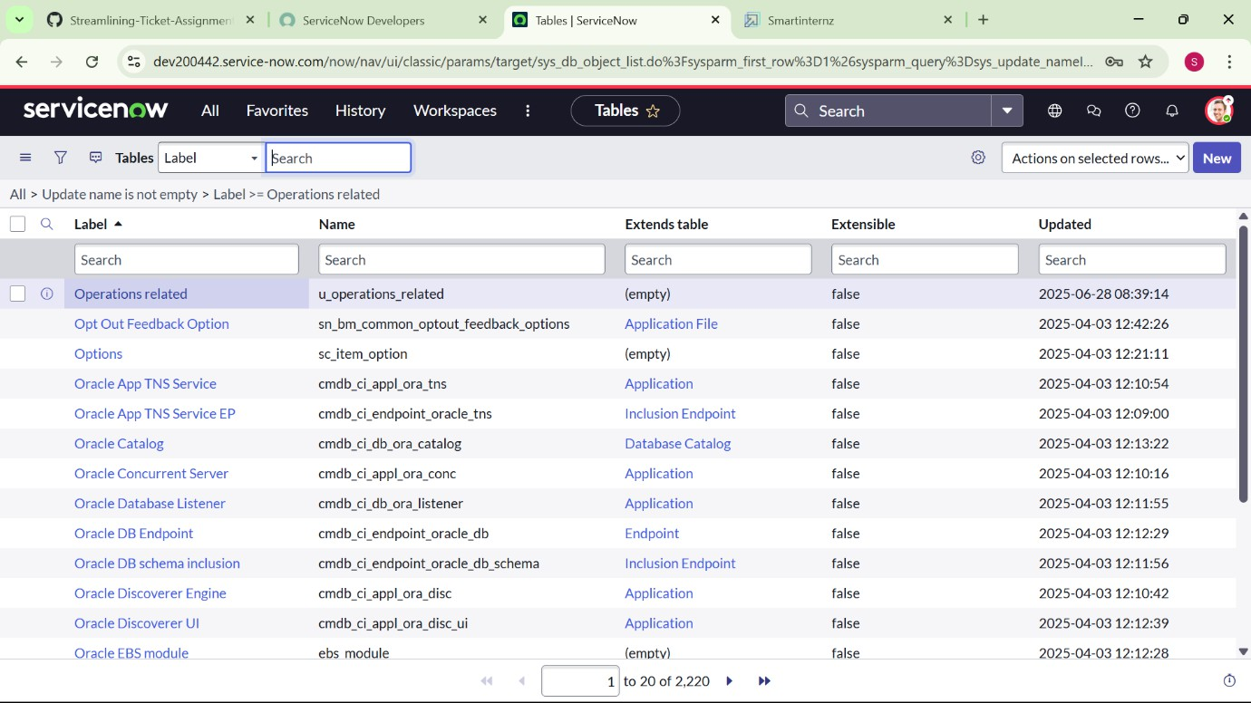
Result:
Step-5:
Assign roles & users to certificate group
Open service now.
Click on All >> search for groups
Select groups under system definition
Select the certificates group
Under group members
Click on edit
Select Katherine Pierce and save
Click on roles
Select Certification_role and sav Step-6:

Slide 9
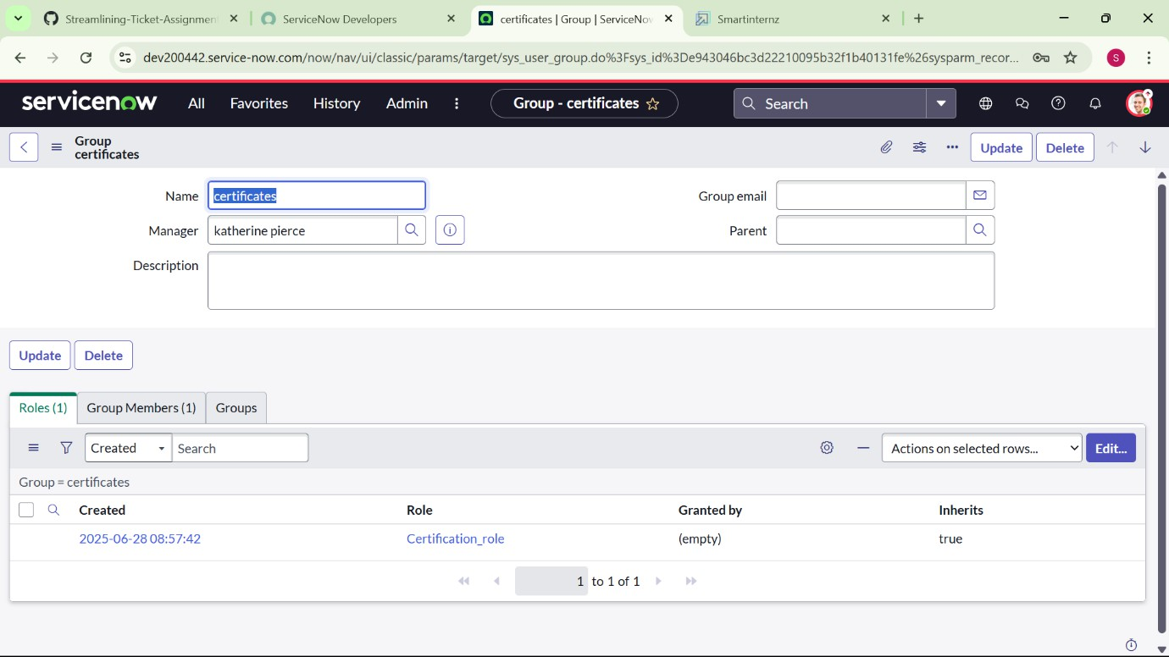
Assign roles & users to platform group
Open service now.
Click on All >> search for groups
Select groups under system definition
Select the platform group
Under group members
Click on edit
Select Manne Niranjan and save
Click on roles
Select Platform_role and save
Result:

Slide 10
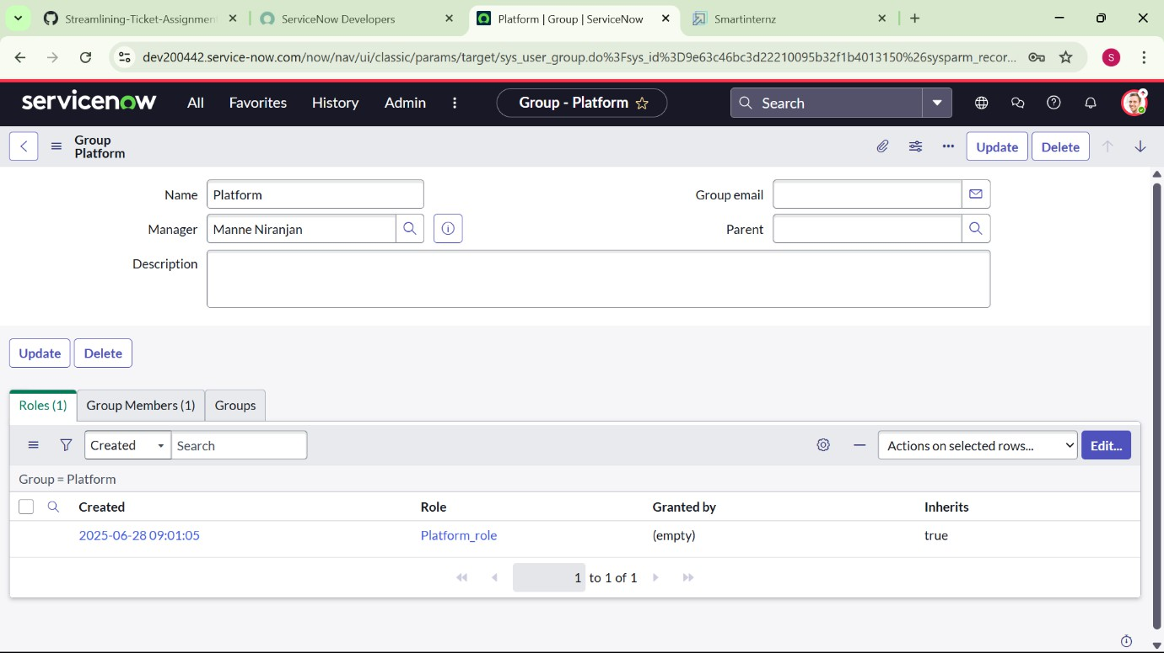
Step-7:
Assign role to table
Open service now.
Click on All >> search for tables
Select operations related table
Click on the Application Access
Click on u_operations_related read operation
Click on the profile on top right side
Click on elevate role
Click on security admin and click on update
Under Requires role
Double click on insert a new row
Give platform role

Slide 11
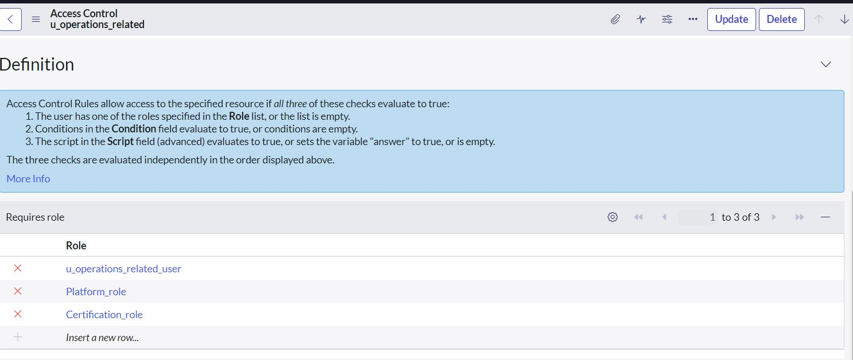
And add certificate role
Click on update
Click on u_operations_related write operation
Under Requires role
Double click on insert a new row
Give platform role
And add certificate role

Slide 12
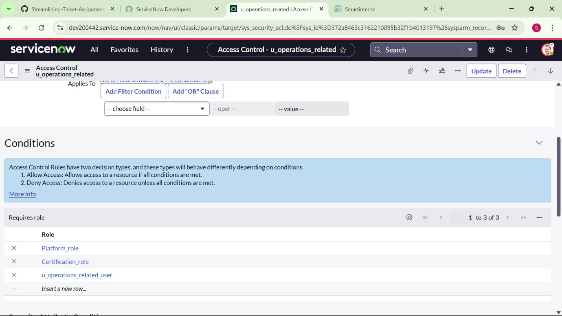
Result:
Step-8:
Create ACL
Open service now.
Click on All >> search for ACL
Select Access Control(ACL) under system security
Click on new

Slide 13
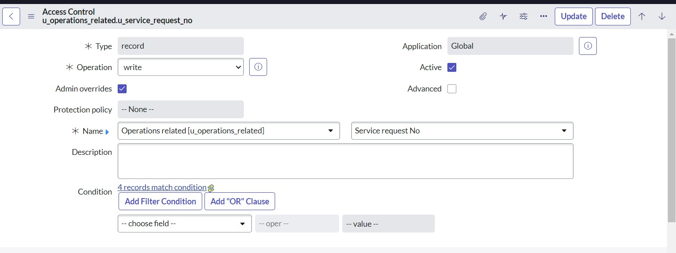
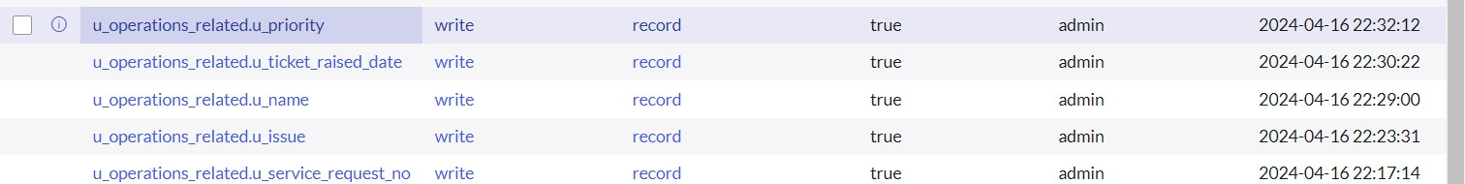
5. Fill the following details to create a new ACL
Scroll down under requires role
Double click on insert a new row
Give admin role
Click on submit
Similarly create 4 acl for the following fields
Result:

Slide 14
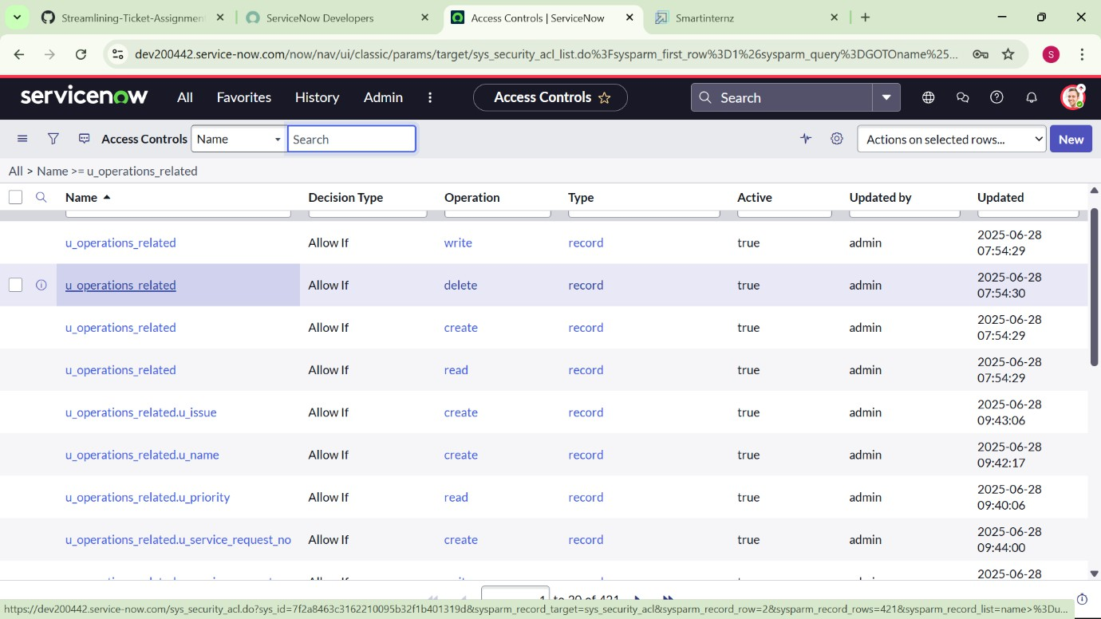
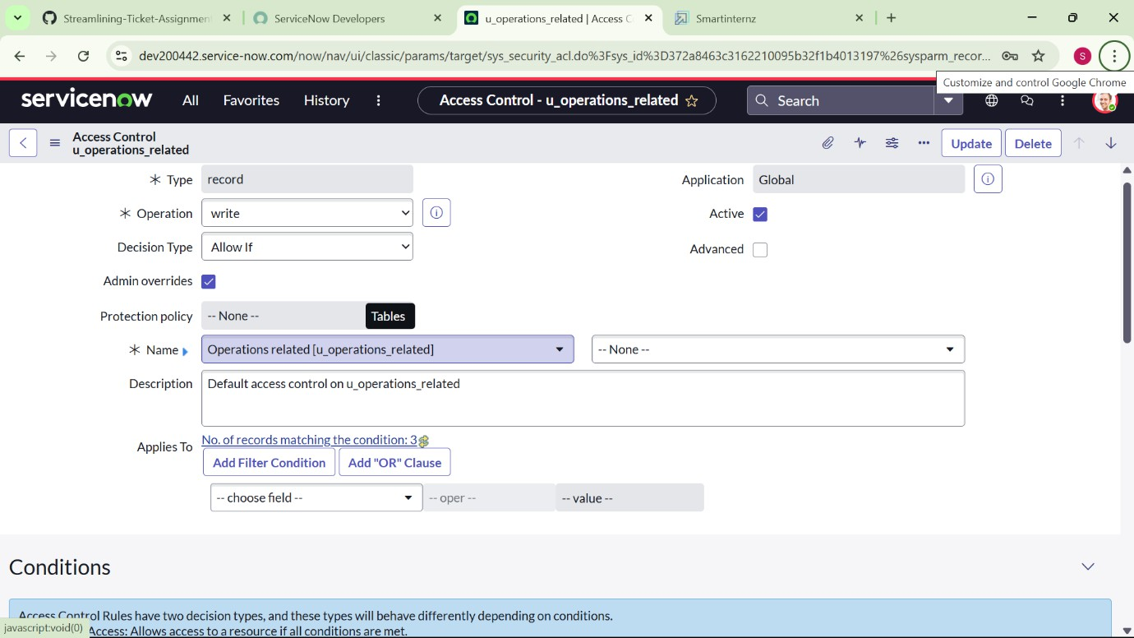
Step-8:
Create a Flow to Assign operations ticket to group
Open service now.
Click on All >> search for Flow Designer

Slide 15
Click on Flow Designer under Process Automation.
After opening Flow Designer Click on new and select Flow.
Under Flow properties Give Flow Name as “ Regarding Certificate”.
Application should be Global.
Select Run user as “ System user ” from that choice.
Click on Submit.
Now add Trigger:
Click on Add a trigger
Select the trigger in that Search for “create or update a record” and select that.
Give the table name as “ Operations related ”.
Give the Condition as Field : issue
Operator : is
Value : Regrading Certificates
After that click on Done.
Now under Actions.
Click on Add an action.
Select action in that search for “ Update Record ”.

Slide 16
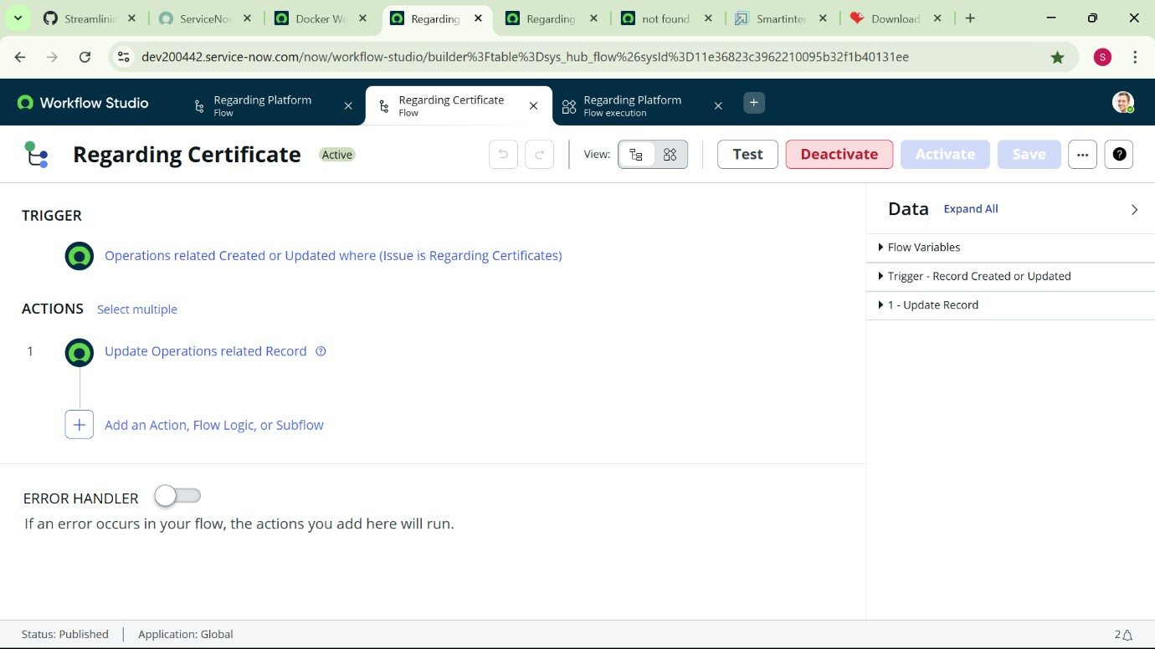
In Record field drag the fields from the data navigation from left side
Table will be auto assigned after that
Give the field as “ Assigned to group ”
Give value as “ Certificates ”
Click on Done.
Click on Save to save the Flow.
Click on Activate.
Result:
Step-9:
Create a Flow to Assign operations ticket to Platform group

Slide 17
Open service now.
Click on All >> search for Flow Designer
Click on Flow Designer under Process Automation.
After opening Flow Designer Click on new and select Flow.
Under Flow properties Give Flow Name as “ Regarding Platform ”.
Application should be Global.
Select Run user as “ System user ” from that choice.
Click on Submit.
Now add Trigger:
Click on Add a trigger
Select the trigger in that Search for “create or update a record” and select that.
Give the table name as “ Operations related ”.
Give the Condition as Field : issue
Operator : is
Value : Unable to login to platform
Click on New Criteria

Slide 18
Field : issue Operator : is Value : 404 Error
Click on New Criteria Field : issue
Operator : is
Value : Regrading User expired
After that click on Done.
Now under Actions.
Click on Add an action.
Select action in that search for “ Update Record ”.
In Record field drag the fields from the data navigation from left side
Table will be auto assigned after that
Give the field as “ Assigned to group ”.
Give value as “ Platform ”.
Click on Done.
Click on Save to save the Flow.
Click on Activate.

Slide 19
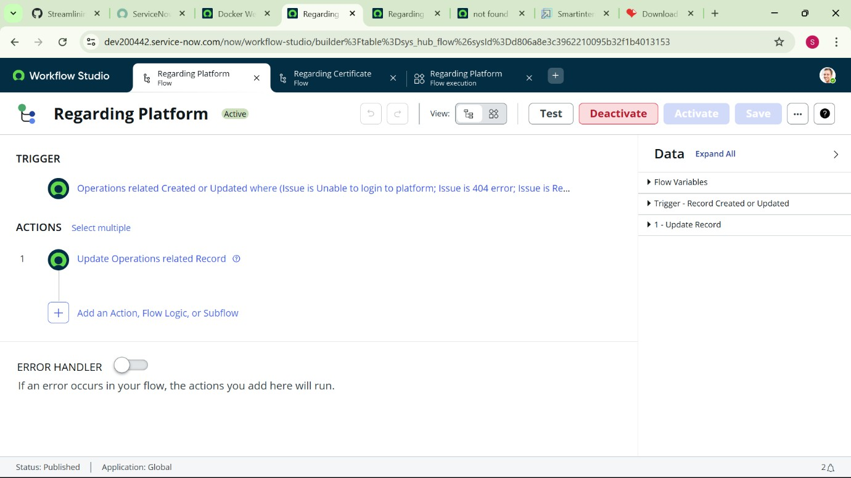
Result:
Conclusion:
The implementation of the automated ticket routing system at ABC Corporation has been a significant success. By
leveraging the capabilities of ServiceNow, we have
streamlined the process of assigning support tickets to the appropriate teams, addressing the challenges of manual routing, and ensuring timely resolution of issues

